Slide 1

Former Village School Site

Slide 2
Brief History
The ownership of the school site was transferred to Guildford Diocese in1957 on Trust to use the property for the purpose of education.
The ownership of the school field was transferred to Surrey County Council in 1967. It contained a covenant that the field should not be used for any other purpose than a playing field for the school.
Dunsfold Infant School closed in 2004 and since then it has been allowed to fall into a state of disrepair.
The Diocese have attempted unsuccessfully to have the covenant on the school site lifted by the Secretary of State for Education and by Charity Commission

Slide 3
Dunsfold Village School Trust (a charitable company) fought the applications to have the covenant lifted and attempted to negotiate with the Diocese to allow the village to take over the site for educational purposes.
The Diocese refused to negotiate and Dunsfold Village School Trust was wound up in September 2019.
The former headteacher’s house was owned by Surrey County Council and was sold to the current owner, who restored the building in accordance with its Grade Two listed status.
The remainder of the school building is now in a very poor state having continued to deteriorate since it closed.

Slide 4
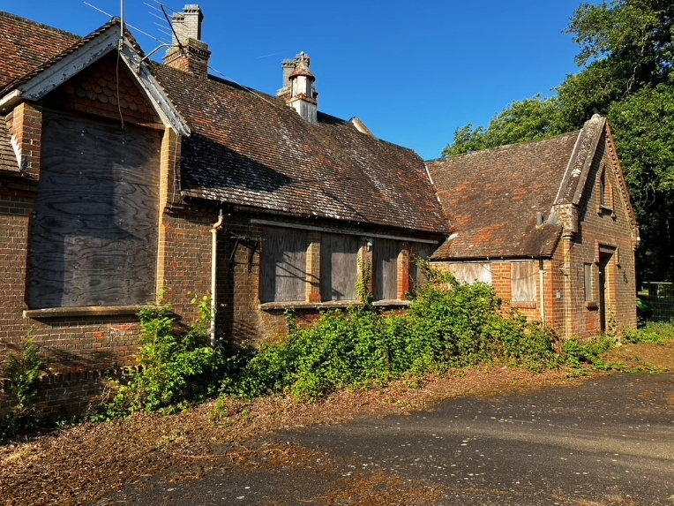
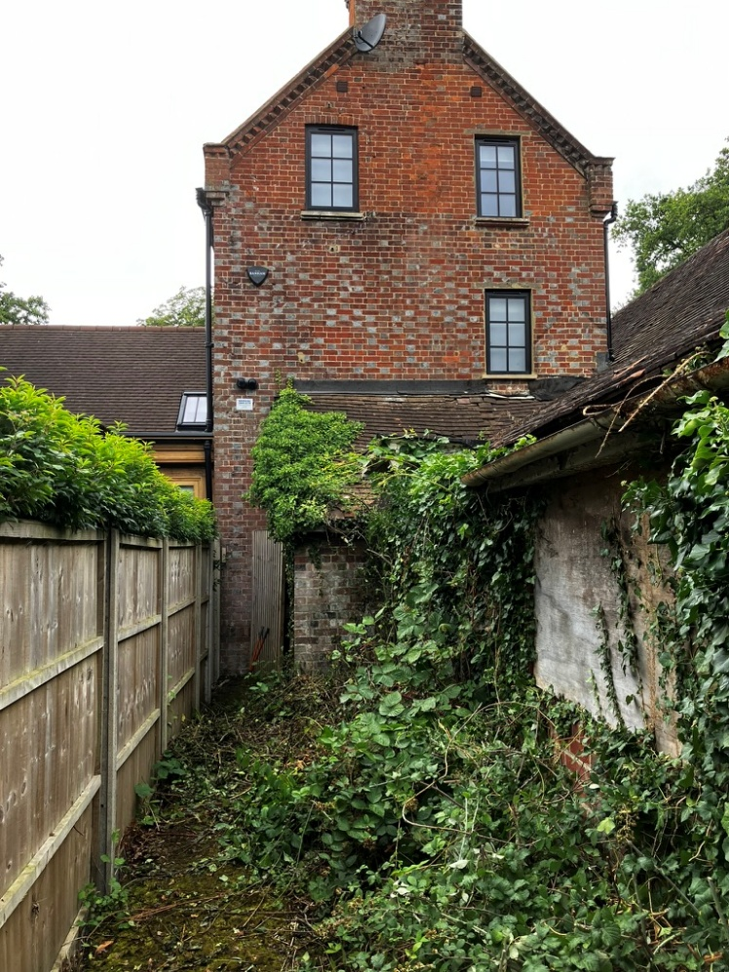
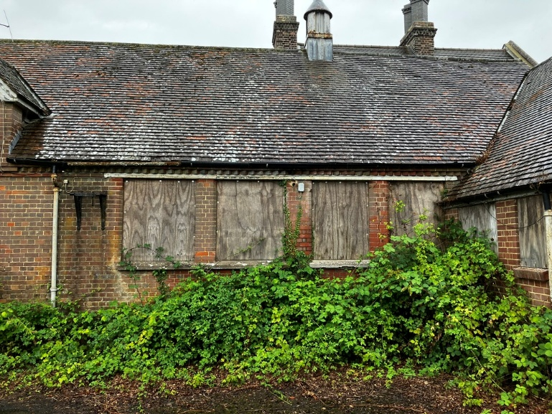
Exterior condition

Slide 5
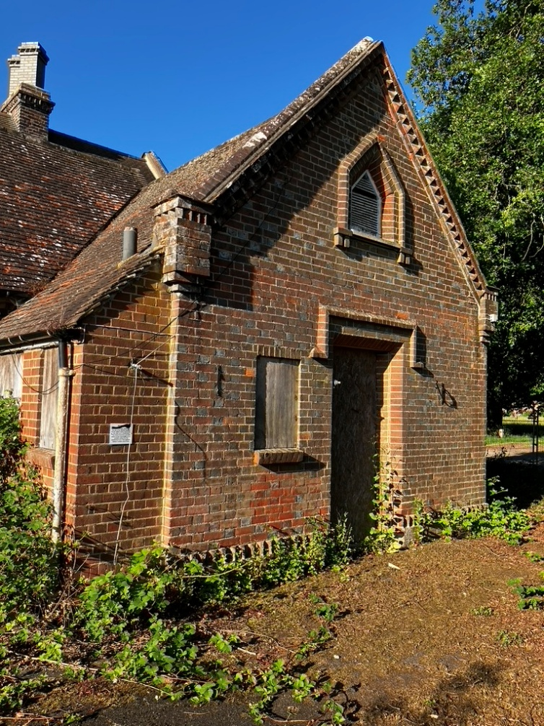
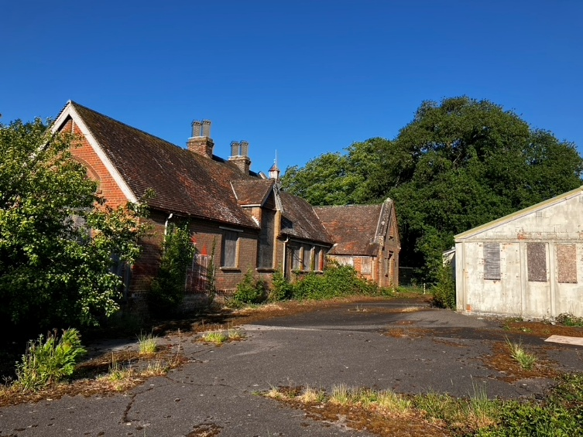

Slide 6
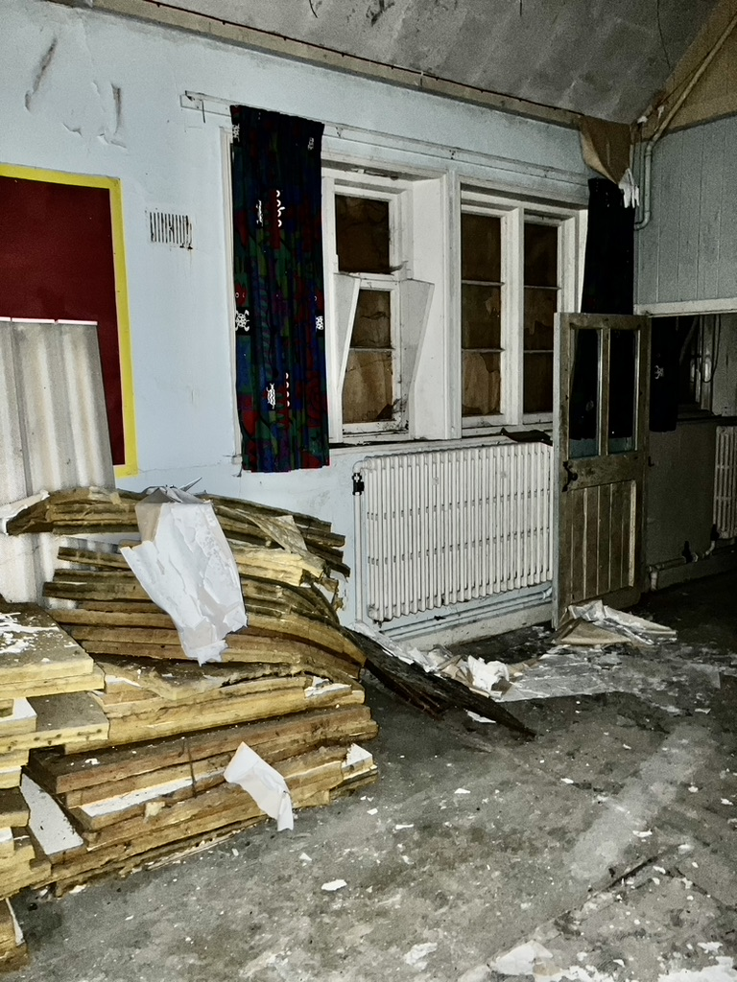
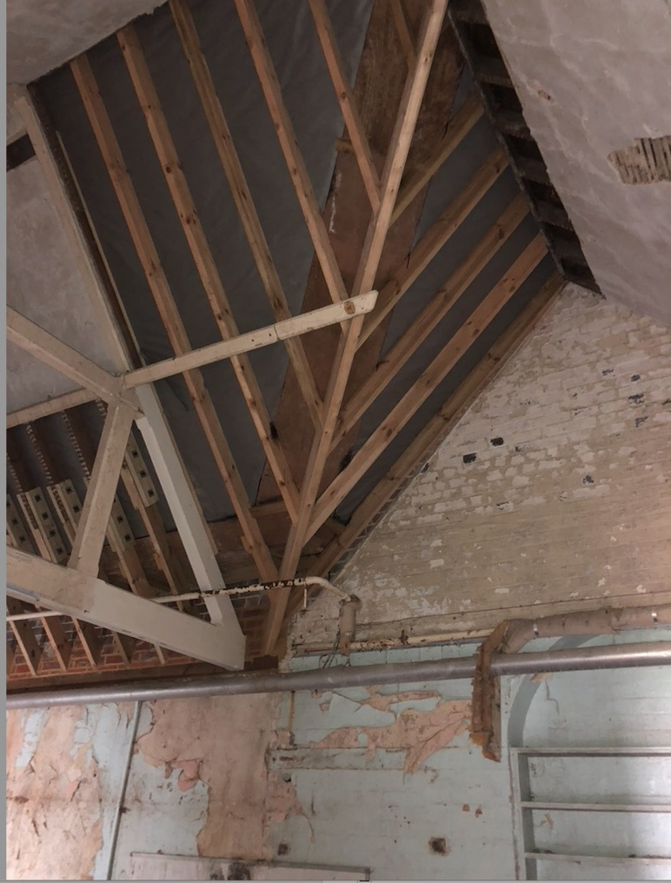
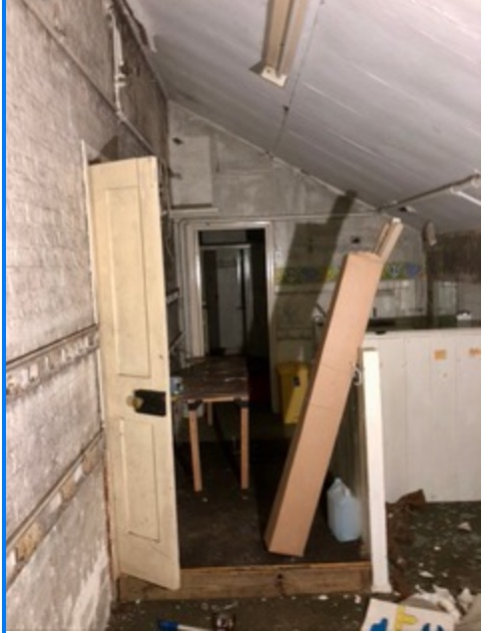
Interior condition

Slide 7
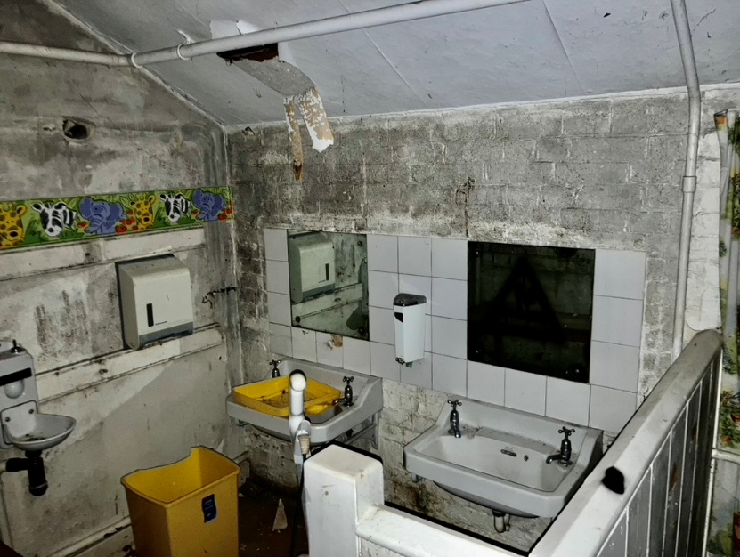
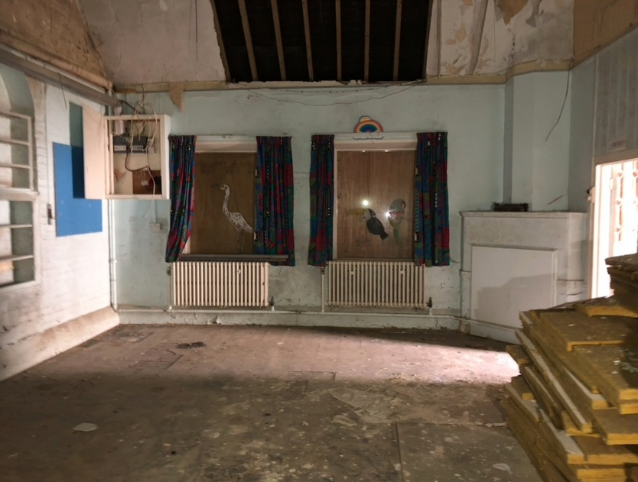

Slide 8
Potential for Educational Use
In the school year 2024/25 there were 351 vacancies in infant schools within a 5 mile radius of Dunsfold.
Birth rates are continuing to fall and Surrey are forecasting the need for school closures.
St Mary’s School Shackleford closed at the end of last academic year and there were sufficient vacancies at Puttenham School to accommodate all of the children.

Slide 9
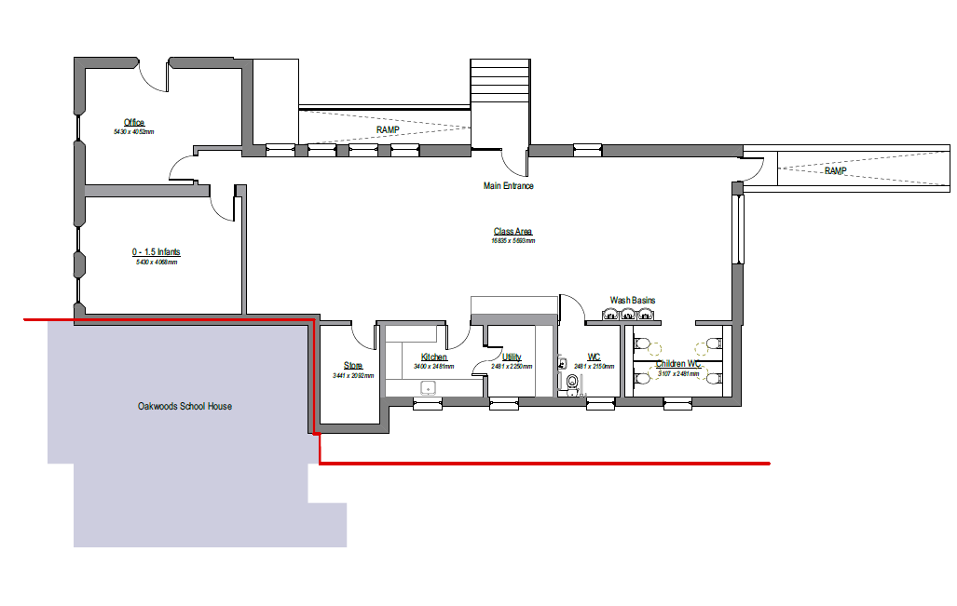
Potential for Pre School / Nursery

Slide 10
Cost of refurbishment
A Brief Order of Cost for refurbishment to complete work to comply with regulations and its listed building status was obtained in January 2025 This was £700,000 plus VAT It did not include demolition of the HORSA building.

Slide 11
Running Cost
Depending on family circumstances parents are entitled to varying amounts of Government funded pre school places for children from 9 months to 4 years of age.
Pre schools cannot legally charge top up fees for these hrs and many are struggling to survive.
After school clubs e.g. from 3.00 – 6.00 p.m. can be charged
The village would have to find an OFSTED approved provider to take on the business
Estimated start up, equipment, staffing and running costs show a loss in the first year of £41,000 on the current rate of Government funding

Slide 12
Use for other Educational Purposes
A range of possible activities were considered from homework clubs to Holliday Programmes and Adult Education and lifelong learning.
The village has two other community venues, the Winn Hall and the KGV Pavilion. Both of them are under used.

Slide 13
Guildford Diocese Proposal
The original classroom at the front of the building would be renovated to the highest standard at no cost to the village.
The freehold of this would be transferred to the village.
This could either be a community facility or a one bedroom flat managed by the PC providing an income for the village.
The rear part of the school building would be converted into one or two homes the sale of which would fund the refurbishment.
At the rear of the site a four bedroomed house to be built the proceeds of which would be retained by the Diocese

Slide 14
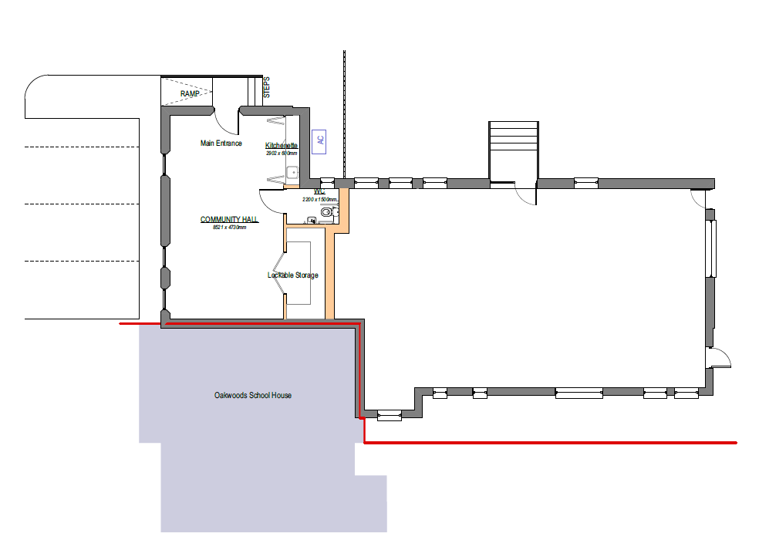
The Diocese Proposal

Slide 15
The Diocese Proposal
These proposals would be subject to agreement from the village that the Parish Council would support an application to have the educational covenant lifted.
The Diocese have stated that this is their final offer.

Slide 16
For Consideration
The village do not own the site and cannot do anything with the site without the agreement of the Diocese.
Due to current school rolls and falling birth rate the Department of Education and the Local Education Authority would not consider opening a school.
If the educational covenant on the school site is lifted Surrey County Council could seek to lift the covenant on the school field.
If the Diocese offer is not accepted, they could continue to do nothing and the building would fall into further disrepair.

Slide 17
The Question
Taking into consideration all of the available information, do you wish the parish council to accept the Diocese of Guildford’s proposal to develop the former school site?
This would involve the transfer of the freehold ownership of the original school room at the front of the building, fully refurbished, to the village. This being subject to the understanding that the council would not object to an application to the Secretary of State for the lifting of the covenant.

